Slide 1
Young Minds at Work -
Astronomical Classification
Kevin Payumo - BITEE AI/ML Research
April 21, 2020

Slide 2
What role does Artificial Intelligence have in Astronomy?
Astronomy and Artificial Intelligence

Slide 3
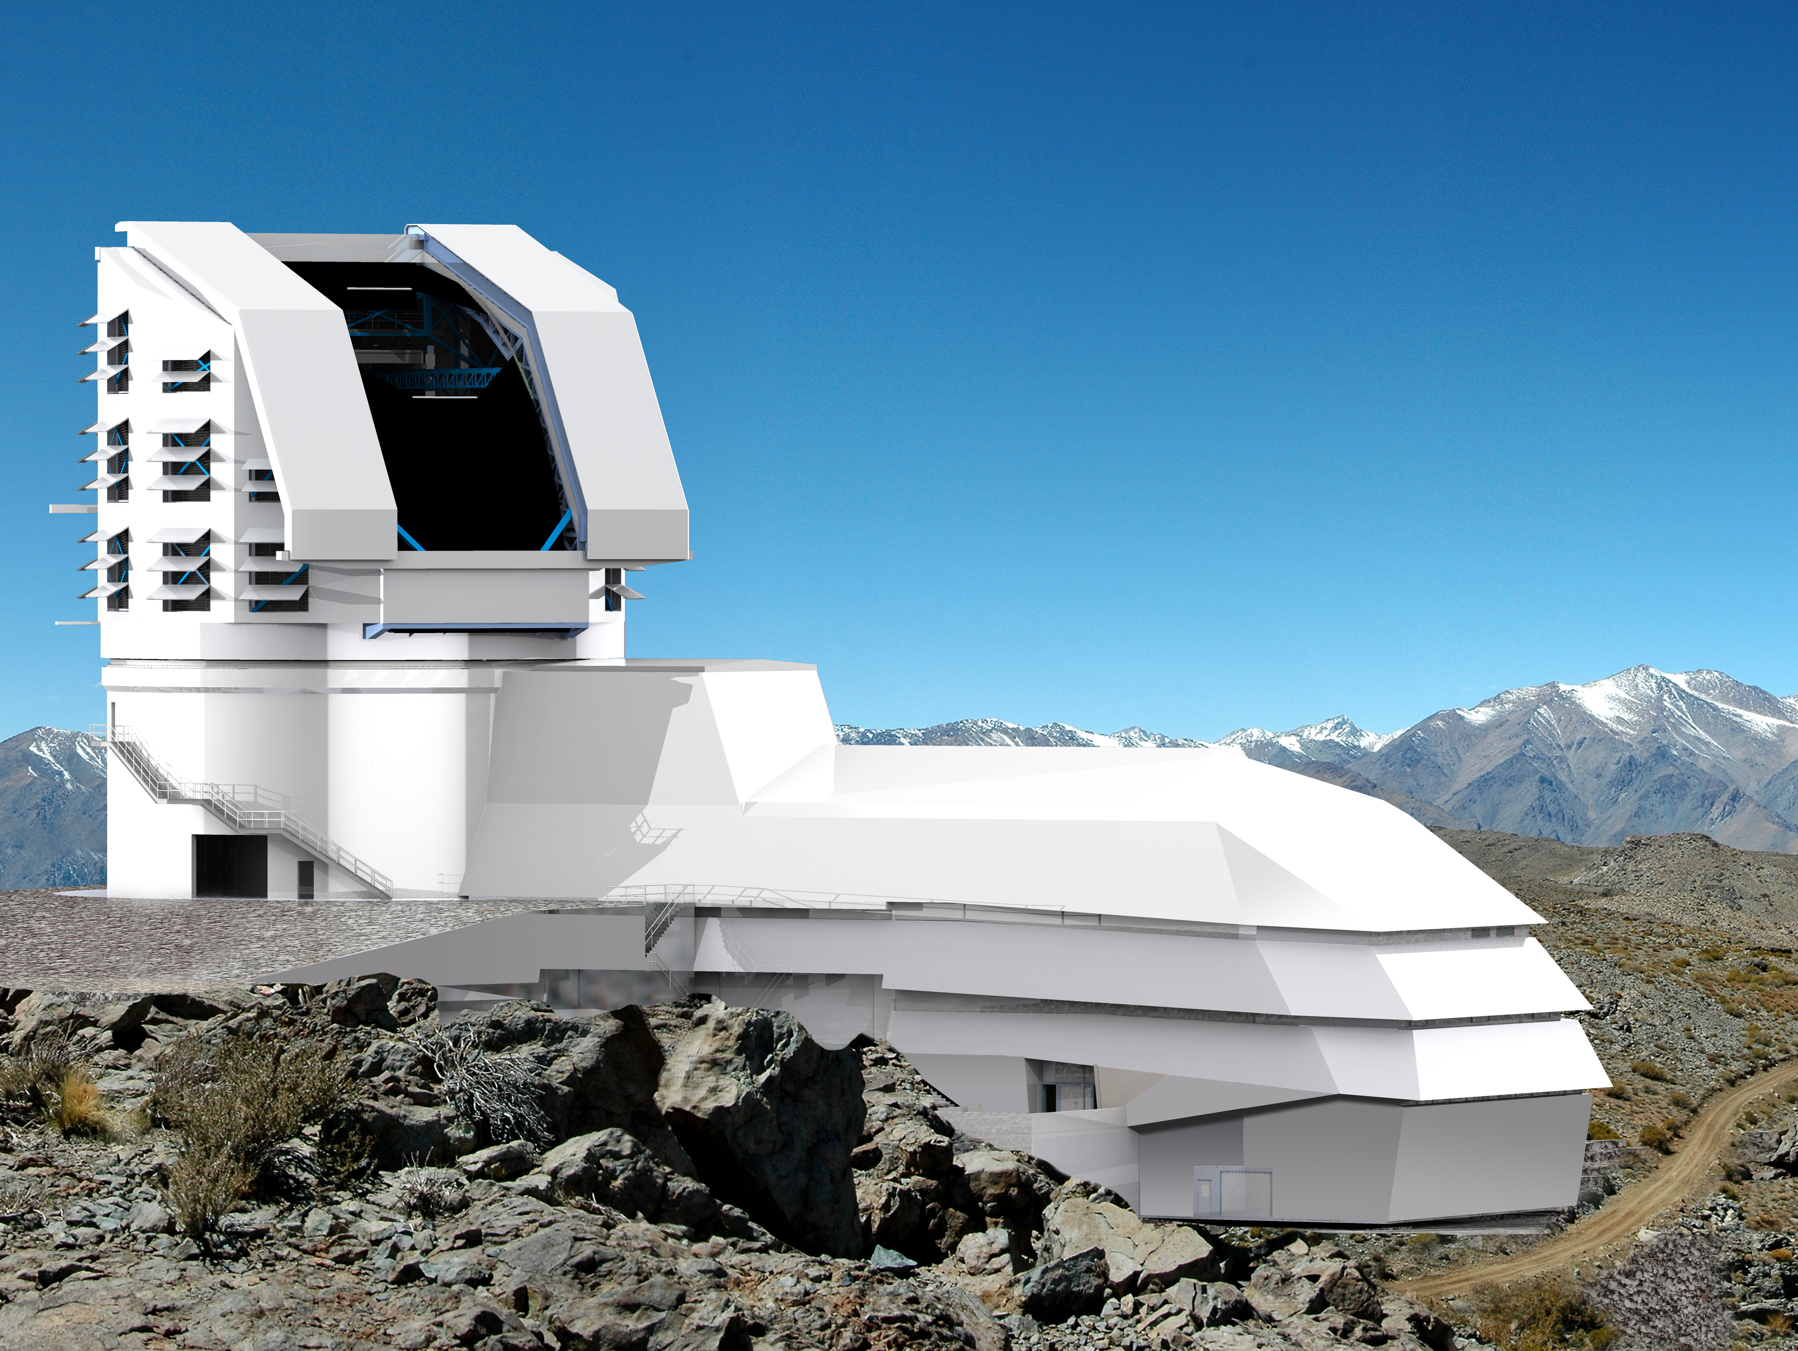
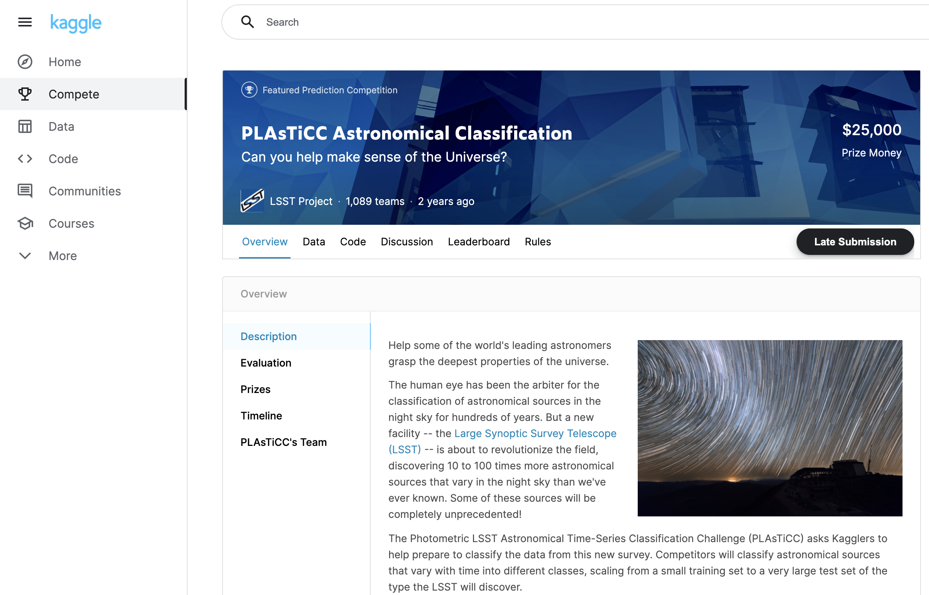
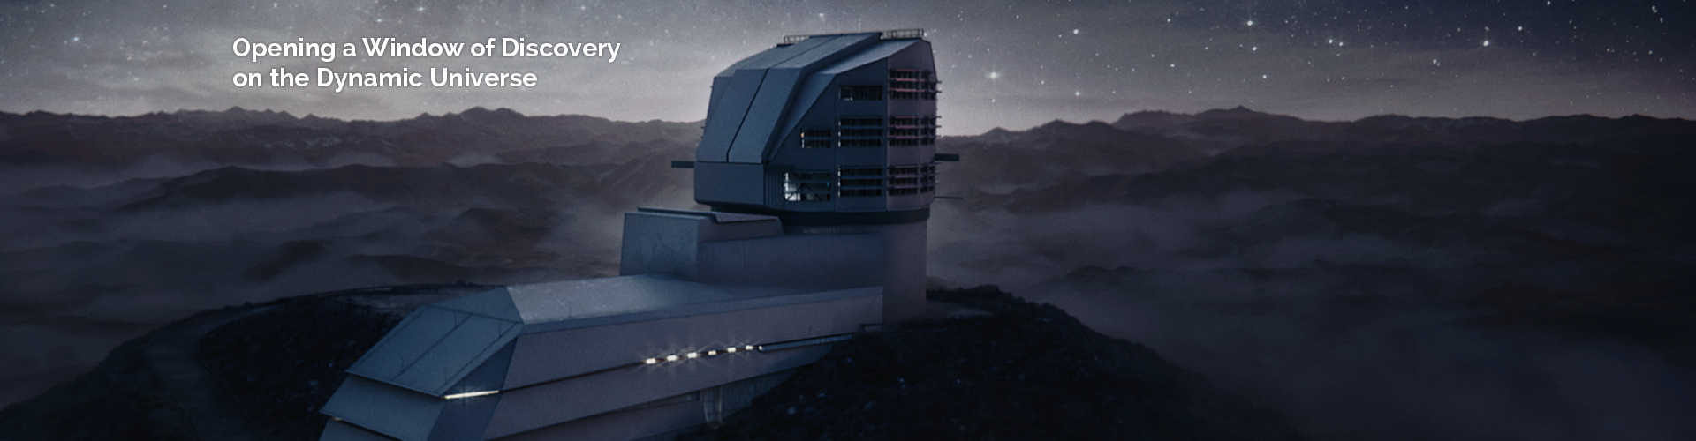
Astronomy and Artificial Intelligence
Vera Rubin Observatory (formerly Large Synoptic Survey Telescope - LSST)

Slide 4
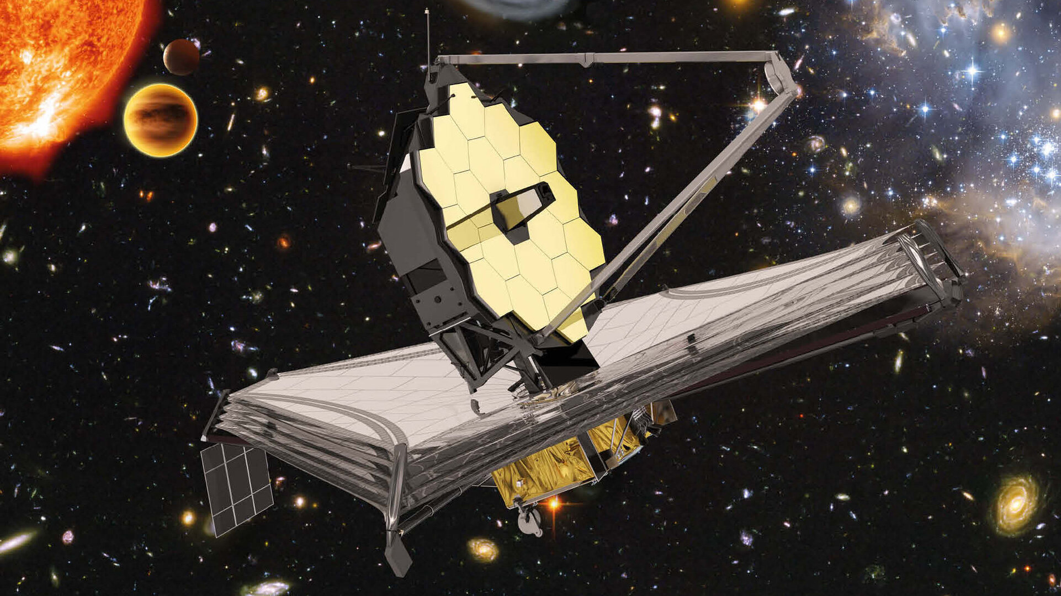
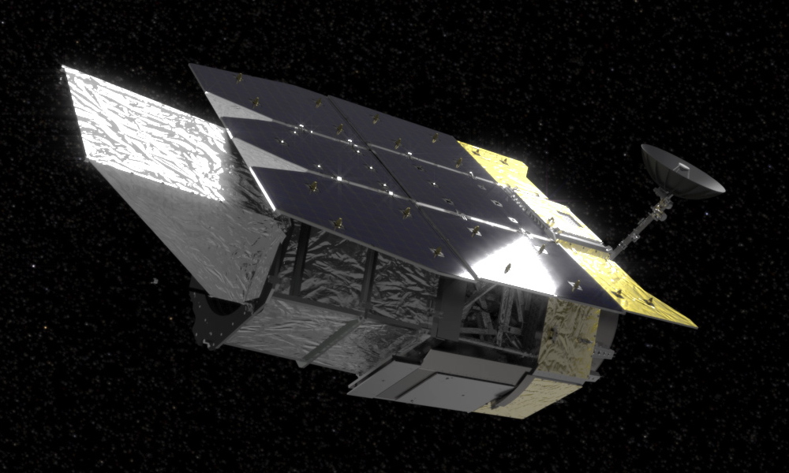
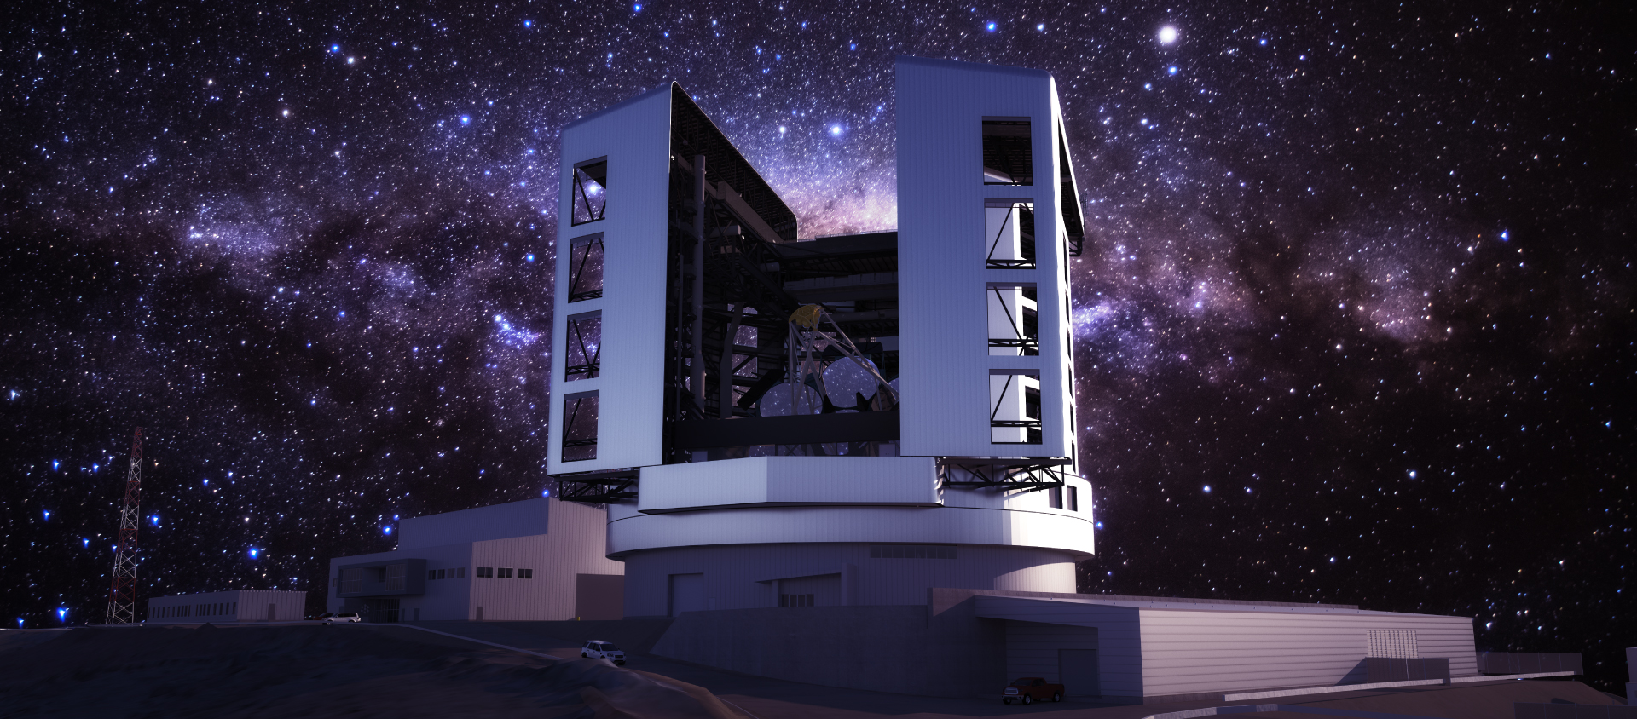
Astronomy and Artificial Intelligence
James Webb Space Telescope
Nancy Grace Roman Space Telescope
Giant Magellan Telescope

Slide 5
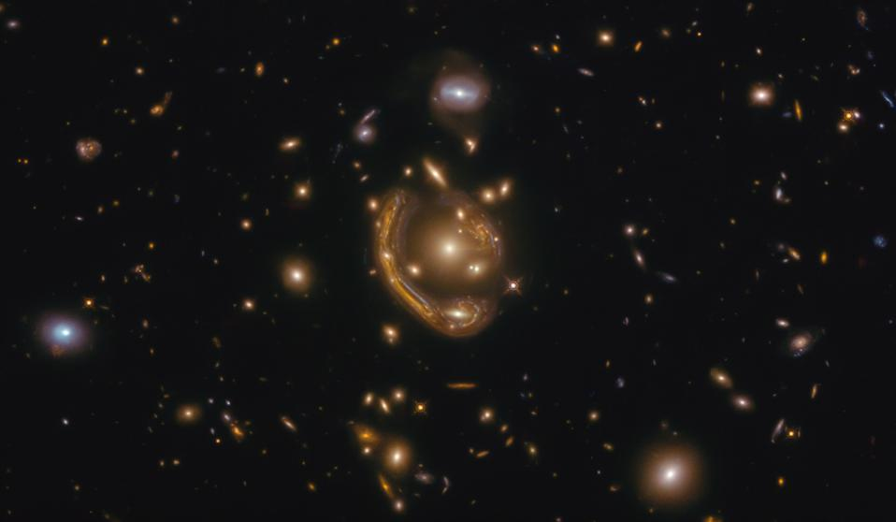
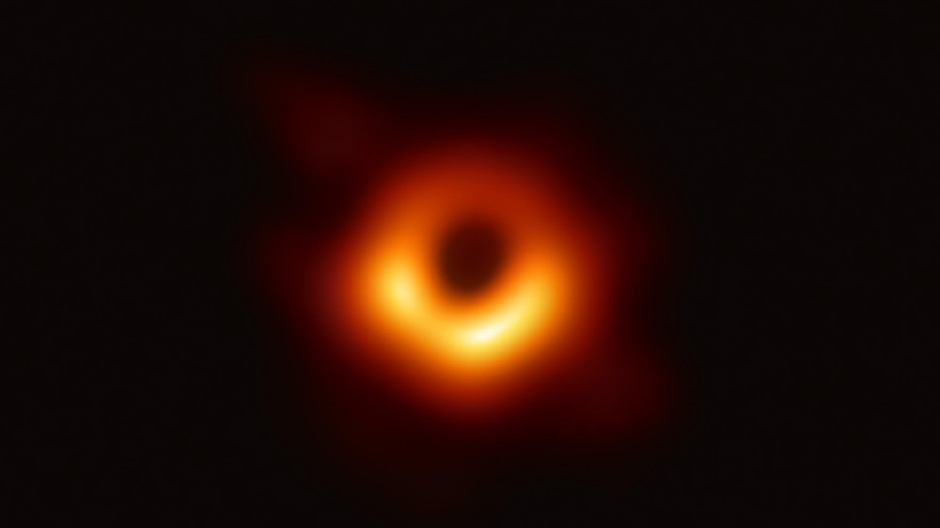
Astronomy and Artificial Intelligence
Gravitational Lenses
- A collaboration between physicists around the world use Deep Residual Networks to find >1200 new gravitational lensing candidates.
https://arxiv.org/pdf/2005.04730.pdf
Black Hole Event Horizon Image
- He Sun & Katherine Bouman applied Deep Probabilistic Imaging to reconstruct the first image of a black hole’s event horizon.
https://arxiv.org/abs/2010.14462

Slide 6
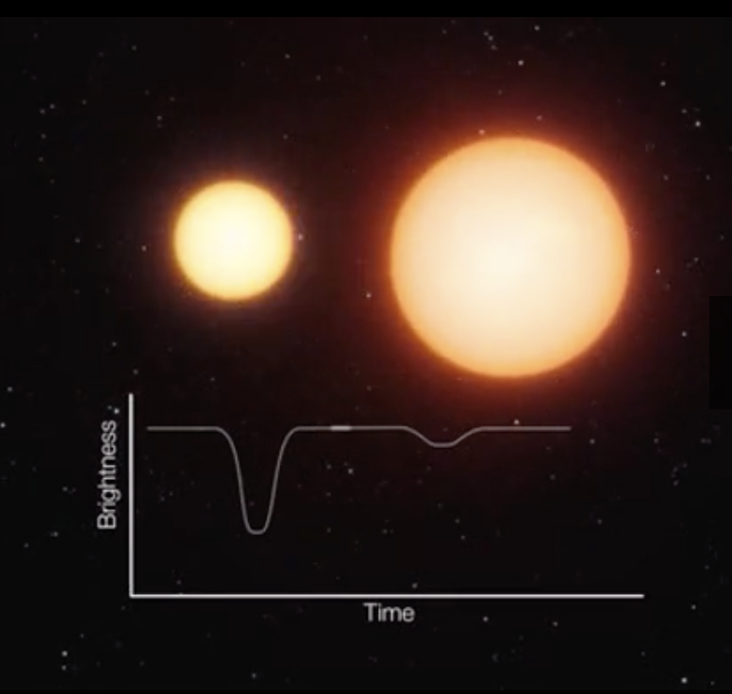
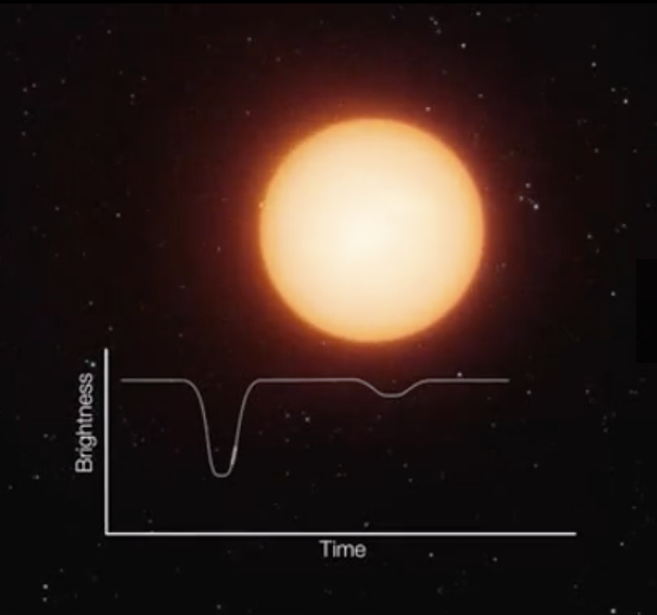
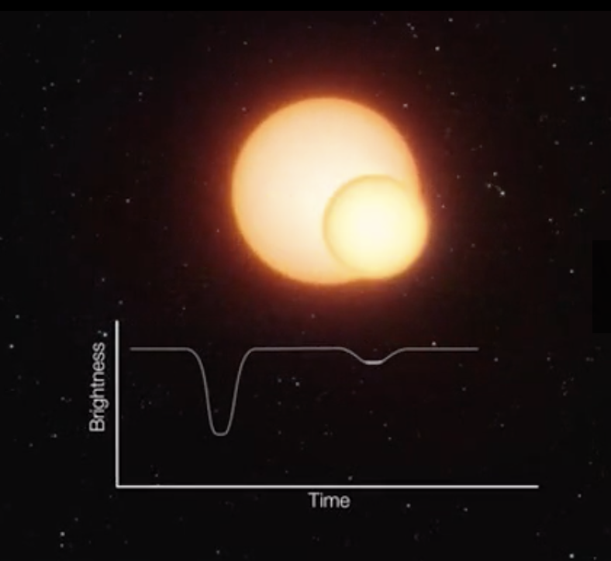
Astronomical Events
Eclipsing Binary Star Systems

Slide 7
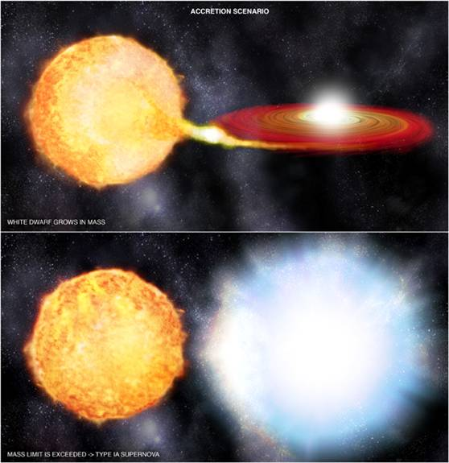
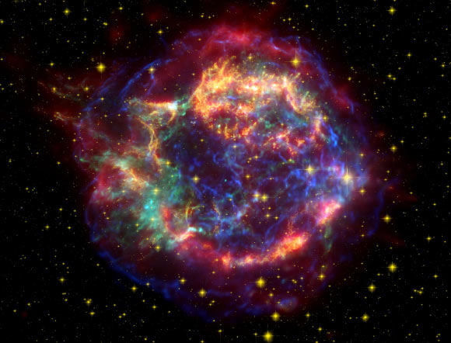
Astronomical Events
Type Ia Supernova - Supernova that occur from a binary star system.
Type II Supernova - Rapid collapse of a dying star leading to a massive explosion.

Slide 8
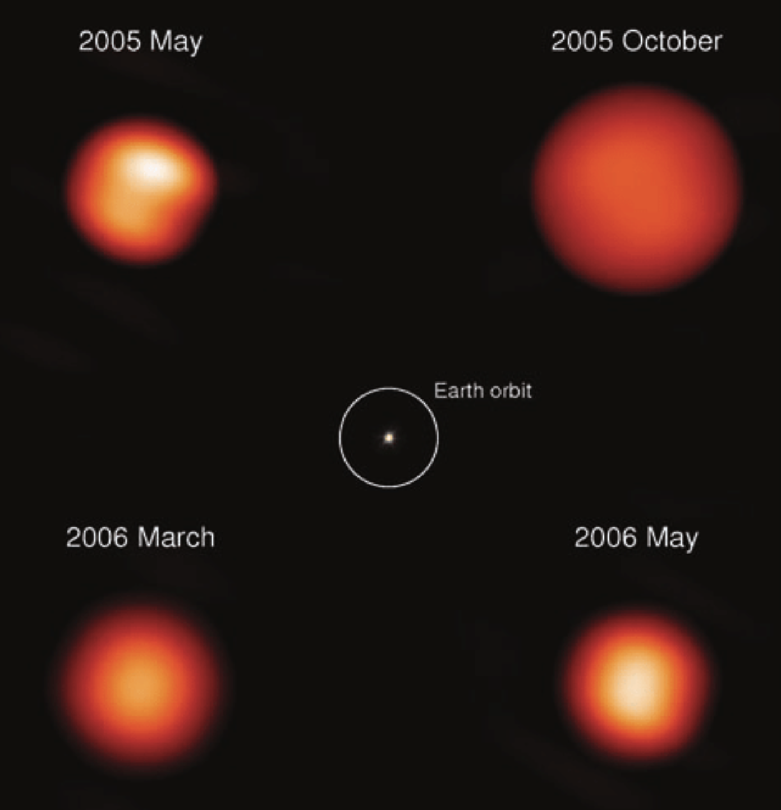
Astronomical Events
Variable Stars
Pulsating mira variable star (Chi Cyg) (SAO/NASA)

Slide 9
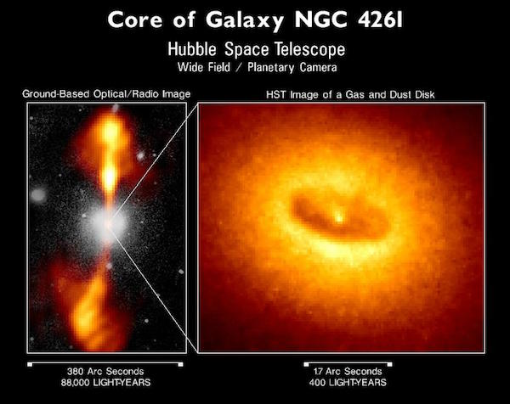
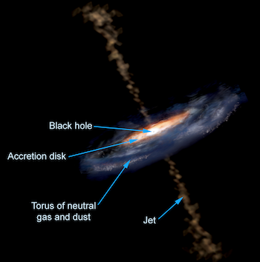
Astronomical Events
Active Galactic Nuclei (AGN)
Features of an AGN (Aurore Simonnet, Sonoma State University)
NGC 4261 - Hubble Space Telescope (NRAO, Cal Tech, Walter Jaffe/Leiden Observatory, Holland Ford/JHU/STScI, and NASA)

Slide 10
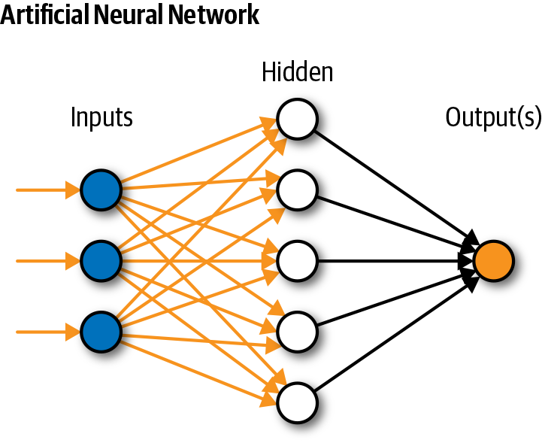
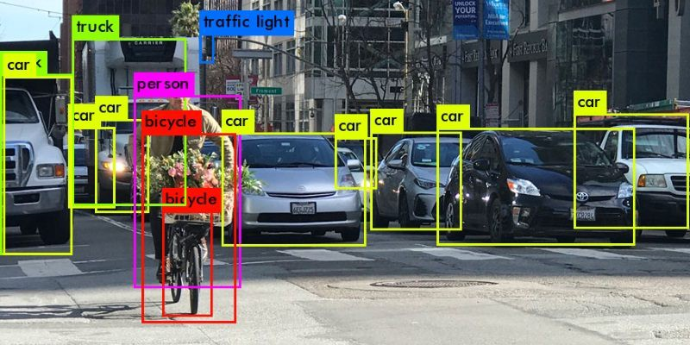
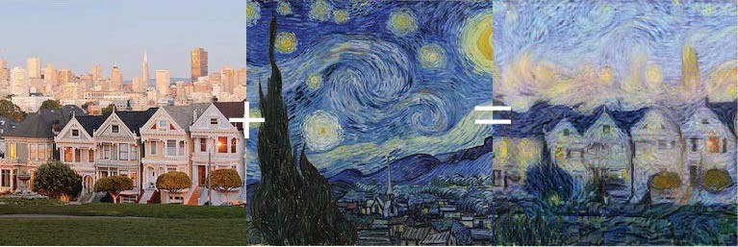
Artificial Intelligence

Slide 11
Activity
https://colab.research.google.com/drive/1nsnAgf86UoCI36_u4C55ucJFIOl7LhsT?usp=sharing

